Slide 1
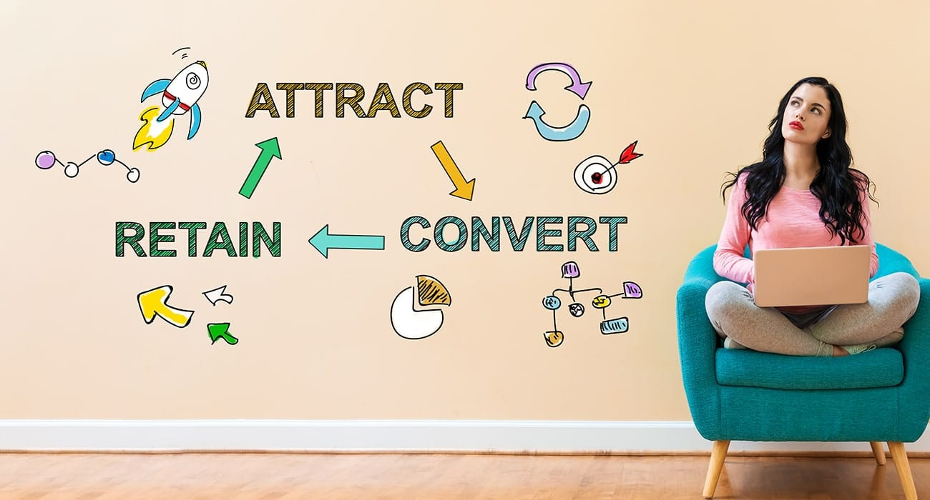
Presentation on CUSTOMER RETENTION
Presented By: Yashshree Baviskar

Slide 2

Agenda
Overview.
About customer Retention?
Need of customer retention.
Problem Statement.
Problem Understanding.
Exploratory data analysis.
Data cleaning.
Visualization.
Analysis
Conclusion.

Slide 3
Overview
In this presentation we’ll look into the following:
What are the different factor affecting customer retention.
What are the criterion to retain customers.
Overall analysis of the problem.
How can we improve customer retention

Slide 4

About Customer Retention
Customer Retention refers to the activities and actions companies and organizations take to reduce the number of customer defections. The goal of customer retention programs is to help companies retain as many customers as possible, often through customer loyalty and brand loyalty initiatives. It is important to remember that customer retention begins with the first contact a customer has with a company and continues throughout the entire lifetime of the relationship.

Slide 5
Need of customer Retention
Less spending on customer acquisition :
Acquiring a new customer can be up to five times more expensive than retaining an existing one.
Increased profits :
An increase in client retention by 5% can enhance profits by over 25% .
Improved online reputation :
Over 37% of customers will only post online reviews if they are “extremely satisfied”.
Positive Reviews :
The longer customers stay with a company, the more business, positive reviews, and they bring word of mouth advertising.

Slide 6
PROBLEM STATEMENT
Customer satisfaction has emerged as one of the most important factors that guarantee the success of online store.
A comprehensive review of the literature, theories and models have been carried out to propose the models for customer activation and customer retention.
Five major factors that contributed to the success of an e-commerce store have been identified as: service quality, system quality, information quality, trust and net benefit.
The research furthermore investigated the factors that influence the online customers repeat purchase intention.
The combination of both utilitarian value and hedonistic values are needed to affect the repeat purchase intention (loyalty) positively.

Slide 7
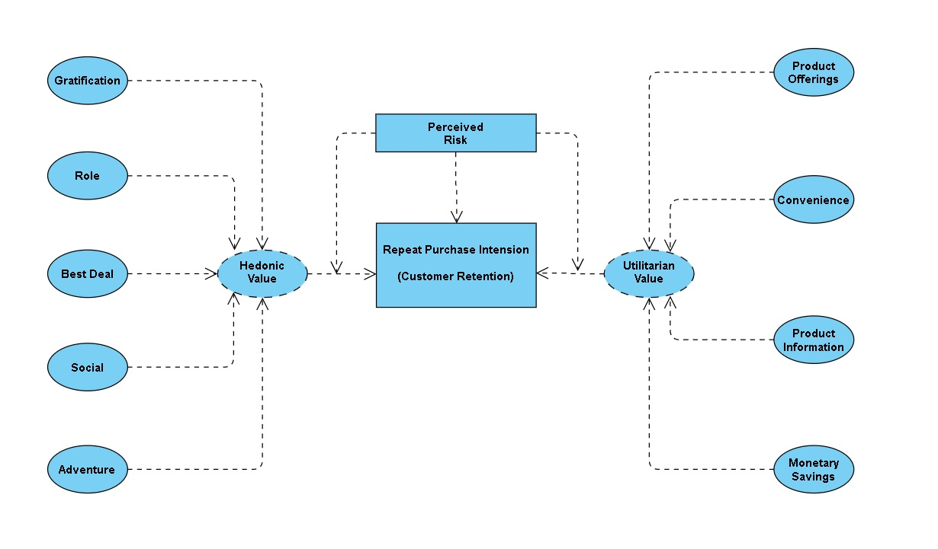

Slide 8
Problem Understanding
Customer Retention means the process of Maintaining or keeping customers once you have acquired.
It’s all about creating loyalty of customer with your brand
It’s about maintaining reputation of your brand
The main motto of this case study is to how one can stop the transition of their customer to other brand.
It’s all about how can long term relationship will be maintain with the customer.

Slide 9
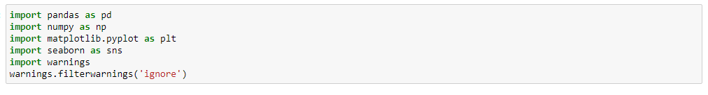
Exploratory data analysis
Firstly, I have imported the required libraries , which we required to analyze the dataset.
Then I have imported the Dataset which was in excel format sing pandas (one of the library that we have imported earlier)
Then I did all the statistical analysis like checking shape, nunique, value counts, info etc.
Then while looking into the value counts I found some duplicate entries in the features i.e., two words with same meaning. I have replaced those duplicates by grouping them.

Slide 10
Data Cleaning
The data type of pincode column was integer type but pincode is a code which will be given to particular location and it will be unique so the datatype should object. So I have changed the datatype of Pincode column if I won’t have changed the datatype it would have carried some wrong information and effected our analysis.
And the column names are very descriptive and they look hard to handle with unnecessary spacing so I have changed my column names which will be helpful for further studies.

Slide 11
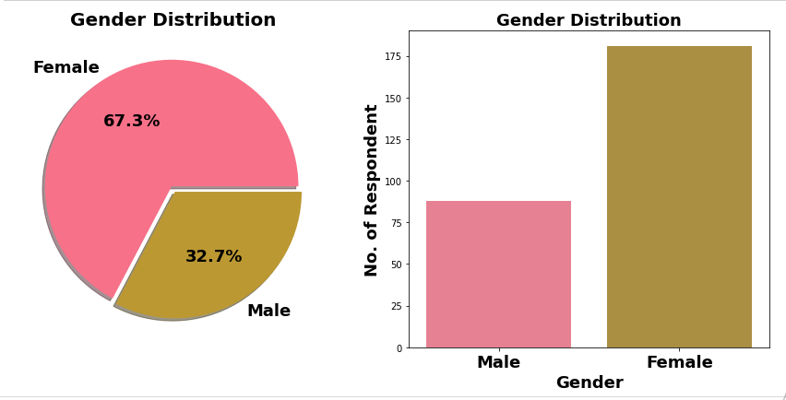
Visualization
Outcome:
- Here almost 181 females and 88 males out of 289
The Majority of Respondent are Female (67.3%) & rest are Male respondent.
This also shows that women are more shopping oriented than men.

Slide 12
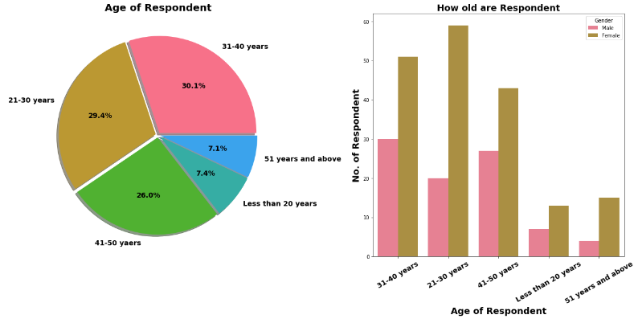
Outcome:
Age Group = No. of People
31-40 years =81
21-30 years =79
41-50 years =70
Less than 20 years=20
51 years and above=19
Majority of female customers are between age group of 21-40 years.
Within Male Customers Tendency of online shopping seen among age group of 31-50 years.
For both gender tendency of shopping is less for age greater than 51 years old.

Slide 13
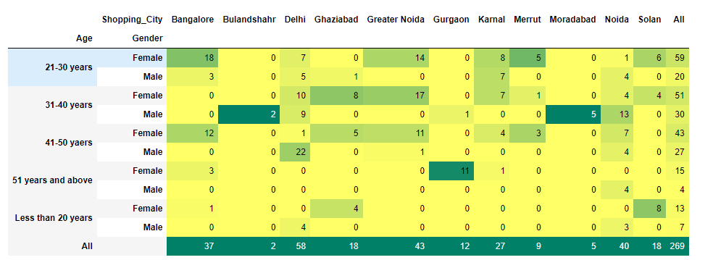

Slide 14
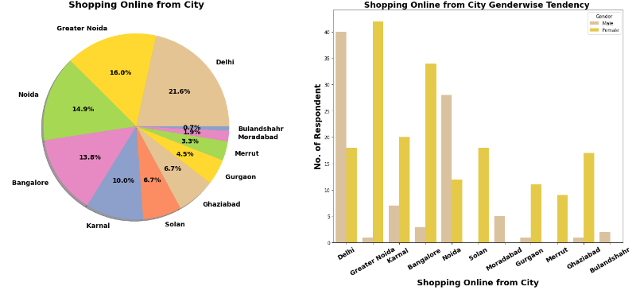
Insights:
Most Online Shopping Customer belong to Metro Cities. and most of them are Male customer
We can conclude that in Metro city like Delhi, Male have more tendency of online shopping. So shopping platform can target this population in marketing.
In Tier 2 & 3 Cities Majority of online shopping customers are Females.

Slide 15
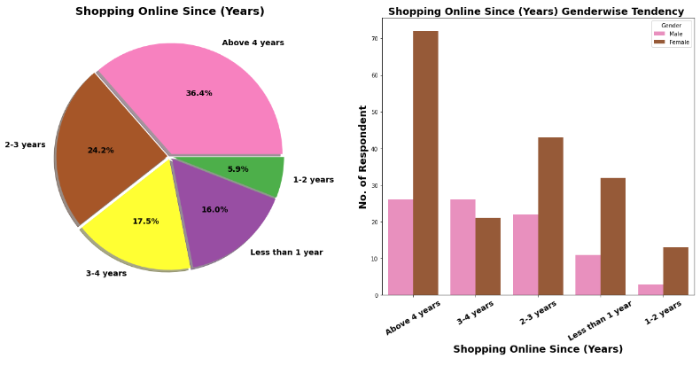
Insights:
36.4% Respondent shopping online since 4 Yrs.
Most of female shopping since 4 Yrs

Slide 16
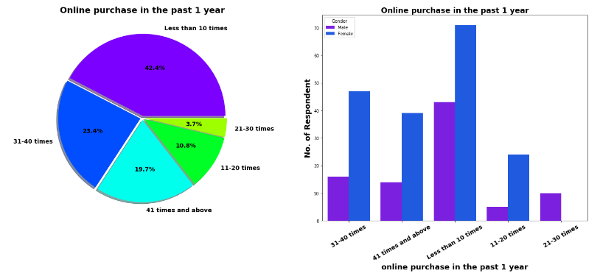
Insights:
42.4% Customers in last 1 year made online purchase less than 10 times.
Around 19.7% customers have made online shopping for 41 times & more in last 1 year. Out which Majority are females.
Another interesting observation no female had made shopping in range of 21-30 times.

Slide 17
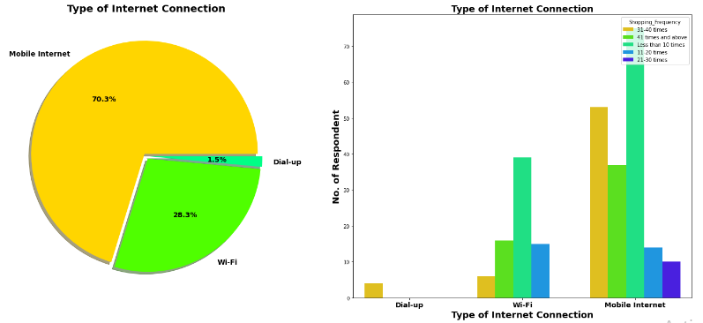
Outcome:
70.3% Customers are mobile internet user followed by WiFi User.
We can see that all customers who made online shopping for 41 times & more are using Mobile internet.
Only 4 user are using Dial up Connection and all of them made online shopping for less than 10 times.

Slide 18
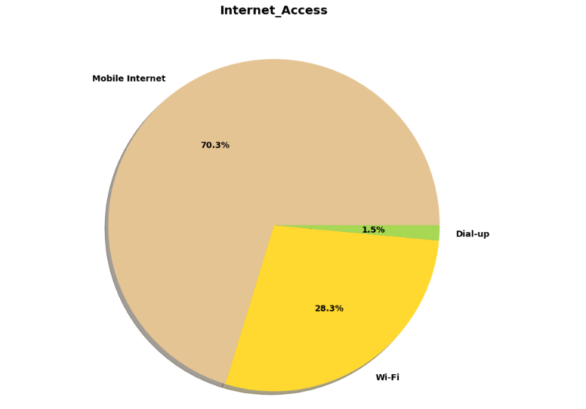
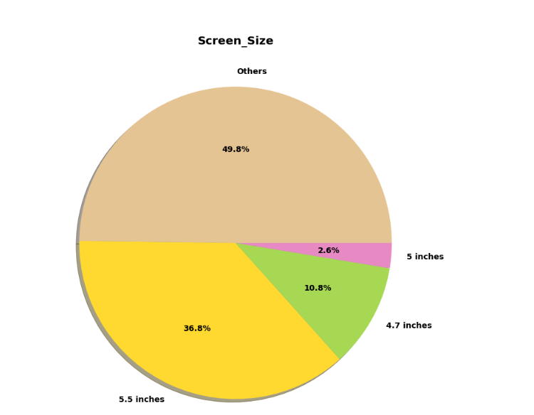
Exploration of internet services & device features

Slide 19
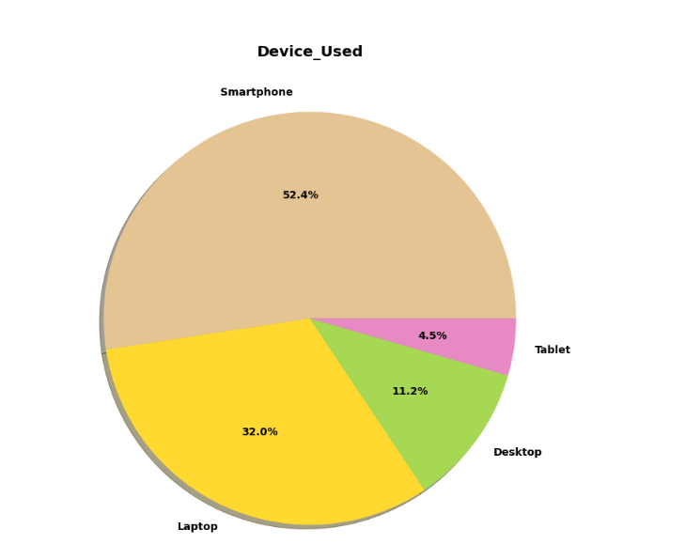
Insights:
70.3% Customer uses mobile internet for shopping.
52.4% Uses Smartphone followed by Laptop for online shopping.
Out of 52.4% Mobile users’ majority have 5.5-inch mobile display screen.
45.4% customer have Windows operating system on their smartphone & laptop.

Slide 20
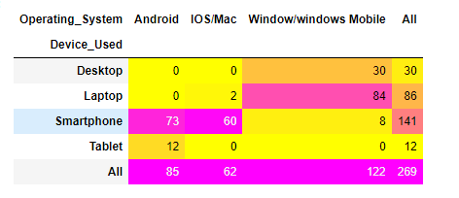
Observation:
No Tablet with IOS operating system.
We already know 45.4% Customer uses Windows OS and here we can see that almost all them come from desktop & laptop user.
Surprising only 2 Customer with Apple laptop.
73 customers using android and 60 customers using Apple iPhone.

Slide 21
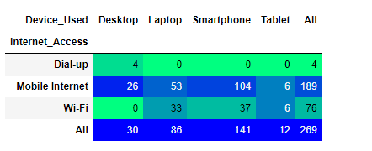
Insights:
No desktop with Wi-Fi Connectivity. All 30 desktop users are using mobile internet or dialup connection.
Out of 141 Smartphone users 104 using mobile internet while rest using Wi-Fi.
We know that in first visit 85% Customer (230 Customer out of 269) came through search engine, here we are trying to figure after 1st visit how many of them reach by others channels like apps or email marketing.

Slide 22
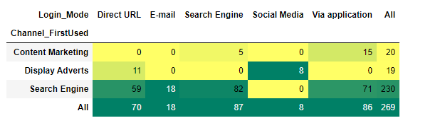
Insights:
For 2nd & afterward visit 71 customer arrived online store via application, followed by 59 via Direct URL & 18 Customer Via Promotional Email Marketing.
Display adverts have very poor performance in landing customer on online store. Similar with Social Media marketing. For 2nd Purchase no one landed through display adverts on search engine.

Slide 23
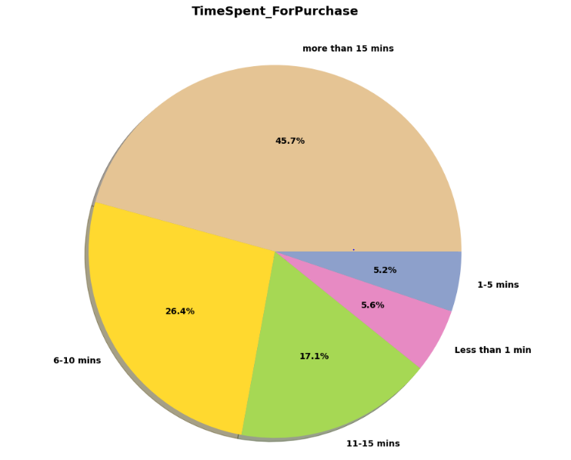
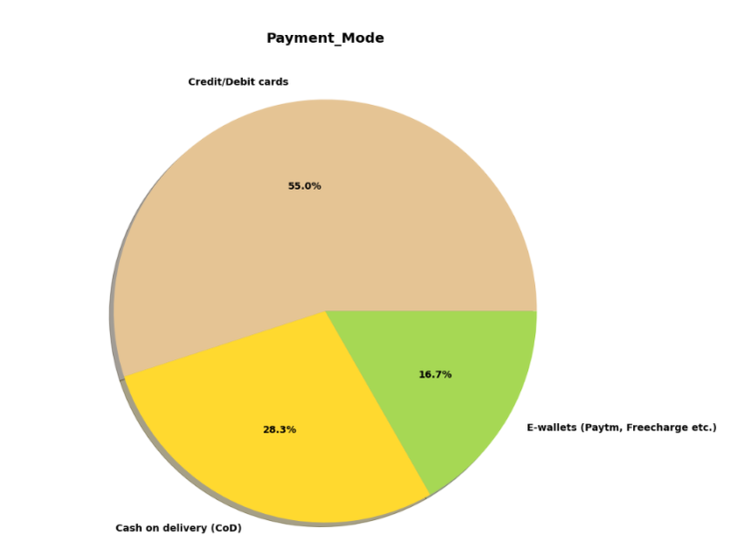
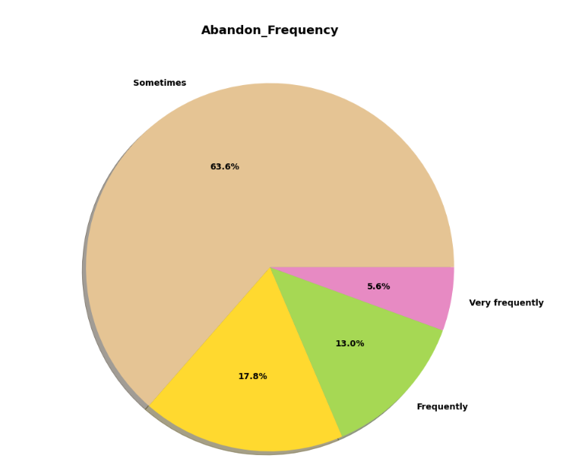
Exploration Purchase Decision & Payment related features

Slide 24
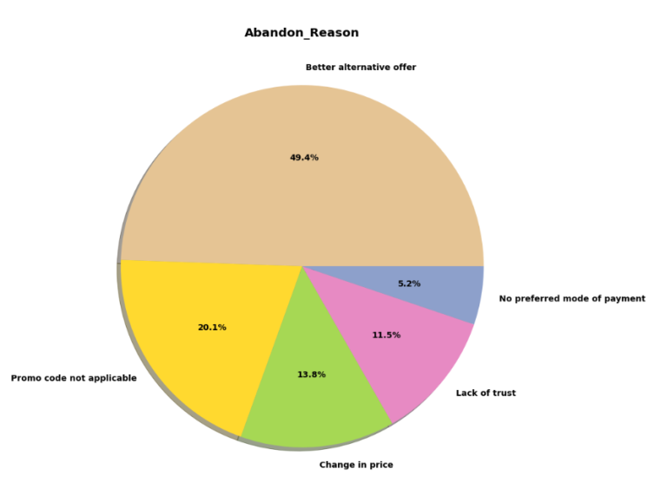
Insights:
45.7% of Customer spend more than 15 mins before making Purchase decision. Followed by the 17.1% customers with 11-15 mins before making purchase decision.
We can see that 5.6% of customers purchase product less than 1 min. It will be interesting to find how many these customers made purchase in past 1 year.
55% of customer paid using credit/debit cards while 28.3% customers still prefer cash on delivery.
We can see that 63.6% of customer add product in cart but later leave without making payment. Surprising there is category of 17.8% customer who never abandon product without making payment.

Slide 25
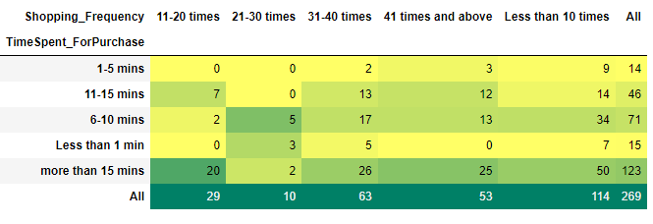

Slide 26
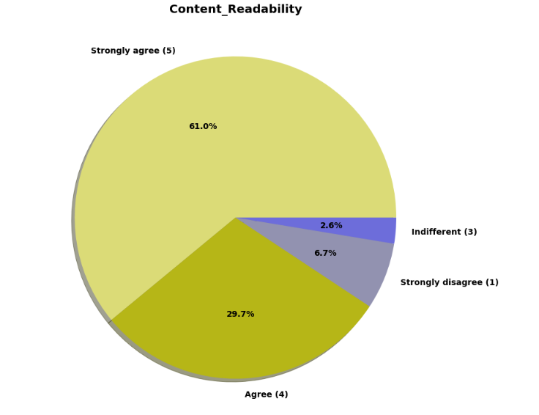
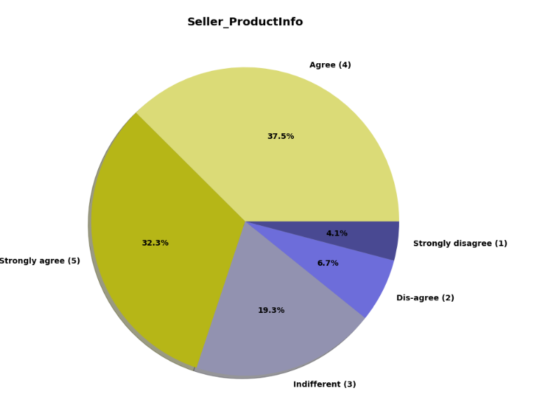
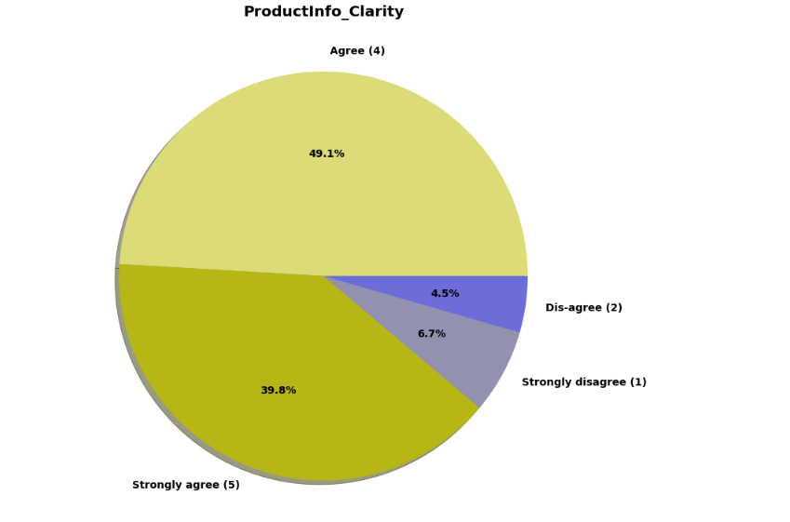
Exporting some Important features of Website Usability & Performance

Slide 27
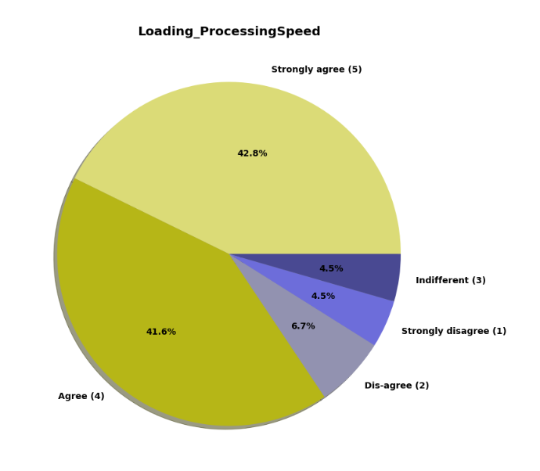
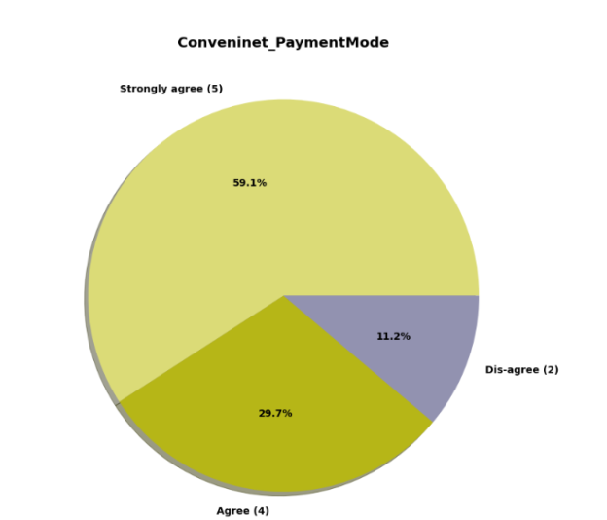
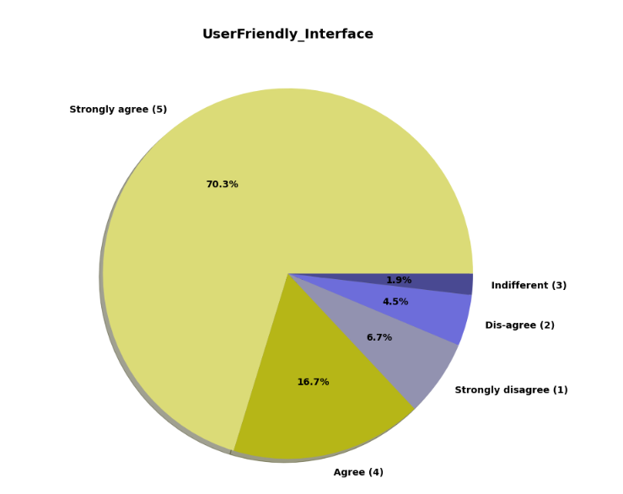

Slide 28
Insights:
61 % customer strongly agree and 29.7% customer agree that content on website must be easy to read and understand.
43.1% customer strongly agree and 34.2% customer agree that information on similar product to highlighted on website for product comparison.
More than 60% of customer agree or strongly agree that complete information on listed seller and product being offered is important for purchase decision.
More than 90% of customer agree or strongly agree that all relevant information on listed products must be stated clearly.
Around 93% of customer agree or strongly agree that website should be easy for navigation.
42.8 % customer strongly agree and 41.6 % customer agree over high loading & processing speed.
70.3 % customer strongly agree and 16.7 % customer agree that website should be user friendly.

Slide 29
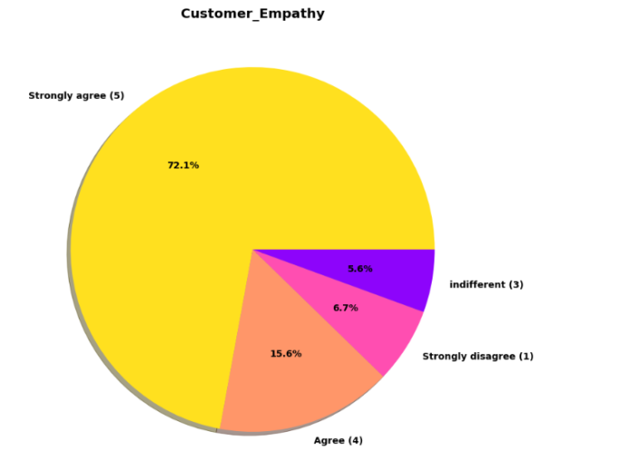
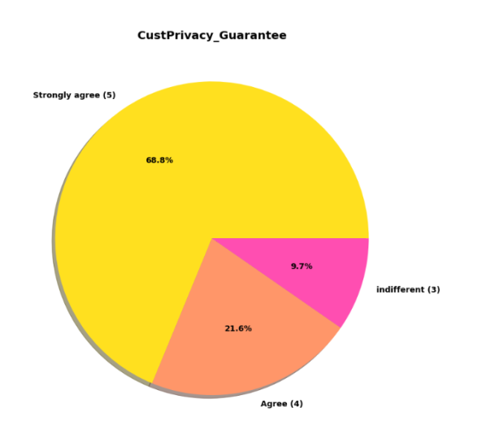
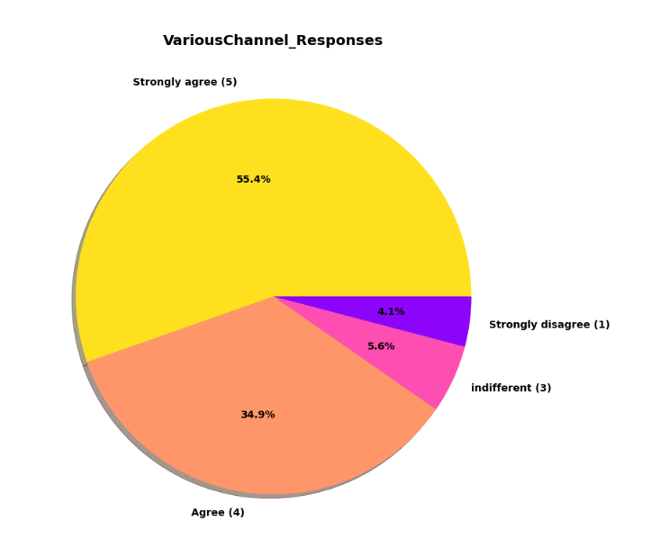
Exploring Online Shopping Store vs Customer Service Requirement

Slide 30
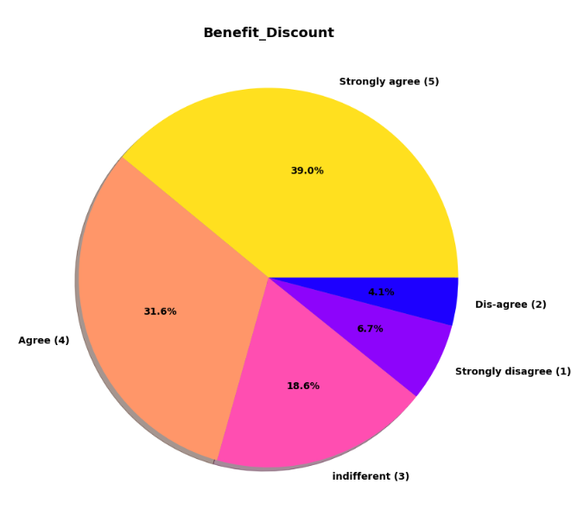
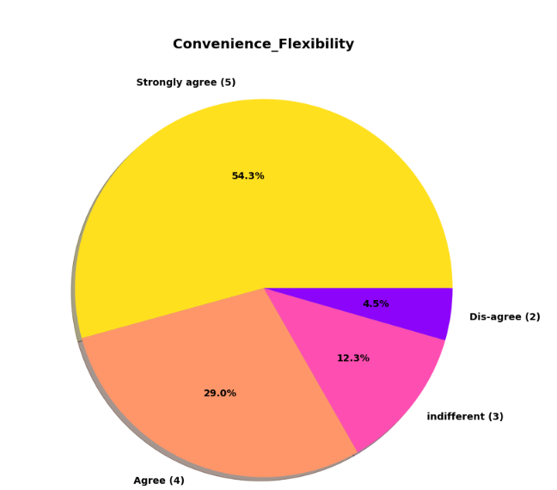
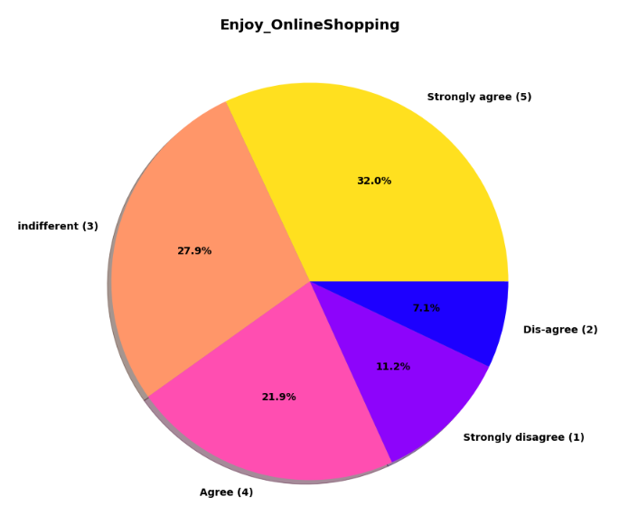

Slide 31
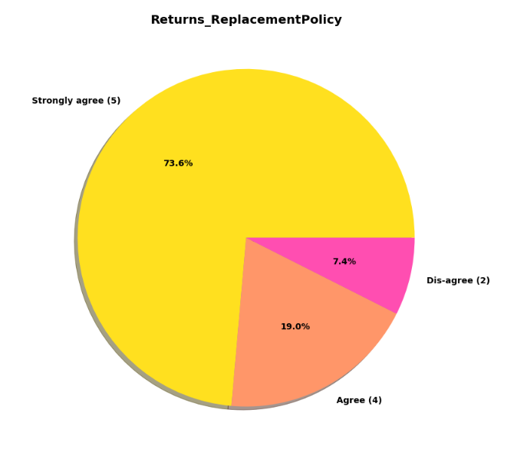
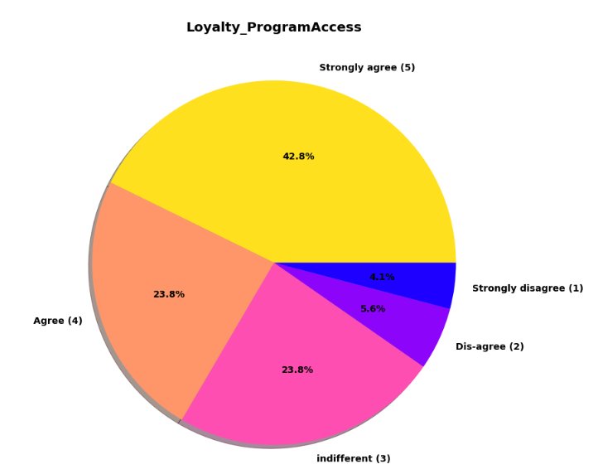
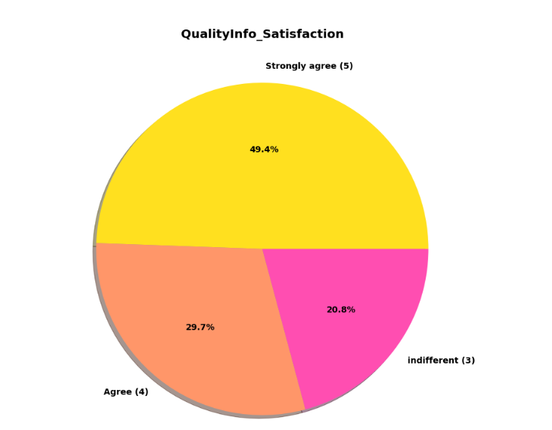
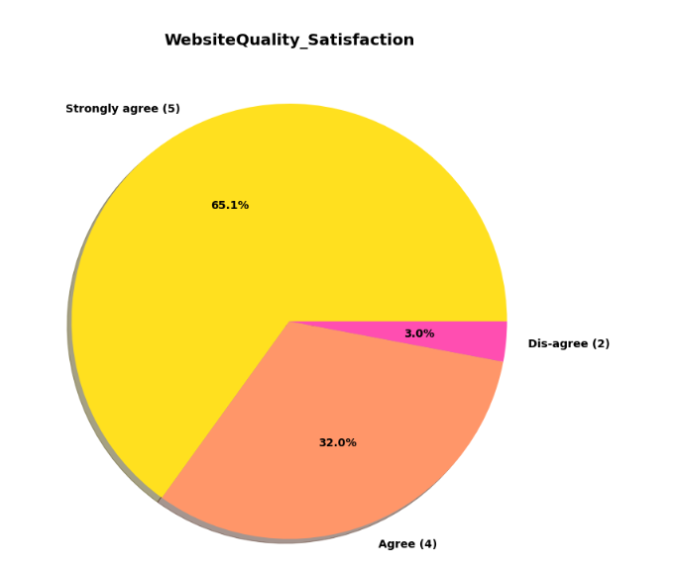
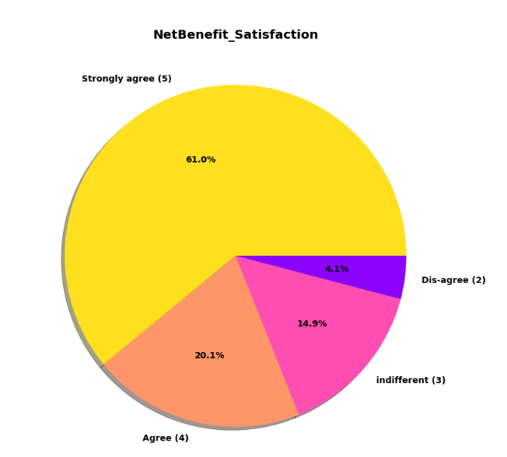
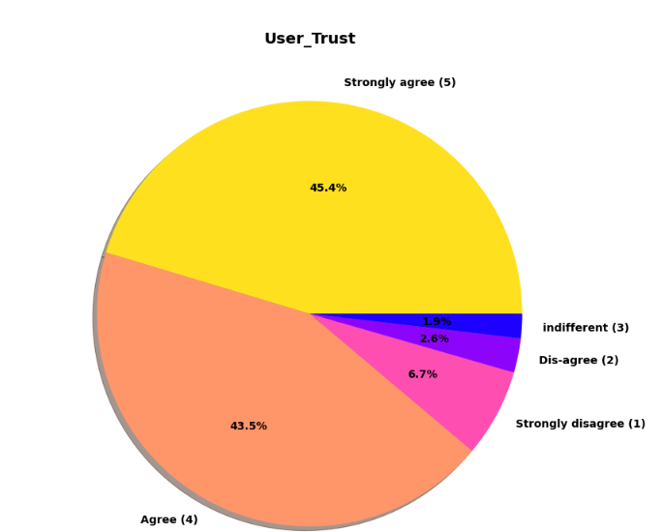

Slide 32
Insights:
72.1% Customer strongly agree thinks that company’s readiness to assist customer queries related to product is important factor in purchase decision.
Pie plot also show that being able to guarantee the privacy of the customer is important silent feature for product selection.
Another most important for product companies is availability of communication channels.
Most of people enjoy physical shopping, we can see that for 32% customer enjoyment from online shopping strongly matter and for around 46% customer this online shopping enjoyment do not matter.
Online shopping is 24/7 available with lot of varieties of product and with product return facility. This led to thinking among almost 85 % of customer thinks, online shopping is convenient & flexible than physical shopping.
73.6% customer thinks that return & replacement policy of e-seller is important factor for making purchase decision.
49.4% customer strongly agree and 29.7% customer agree that displaying quality information on website helps in decision making in turn improves customer satisfaction.
45.4% of customer strongly agree over fact that user satisfaction cannot exist without trust.

Slide 33
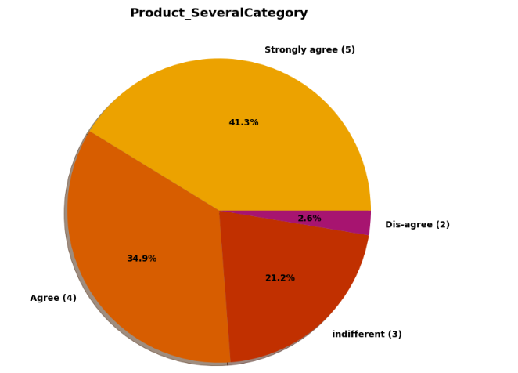
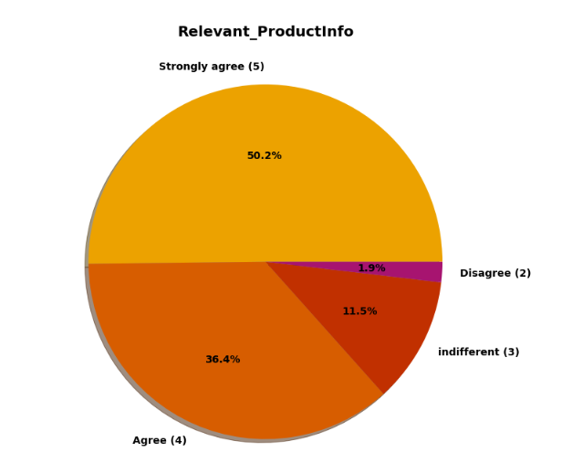
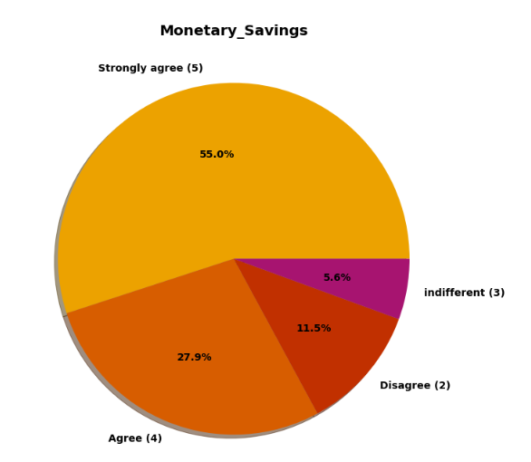
Exploring Feature Related to Customer Online Shopping Experiences

Slide 34
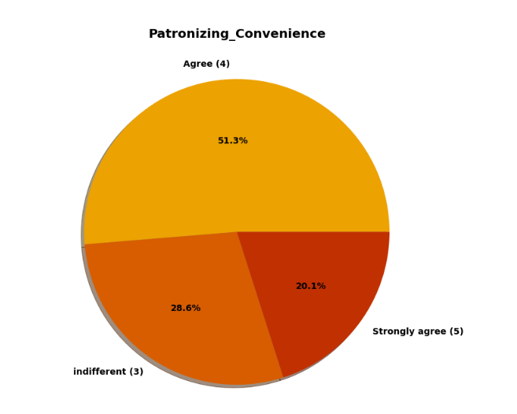
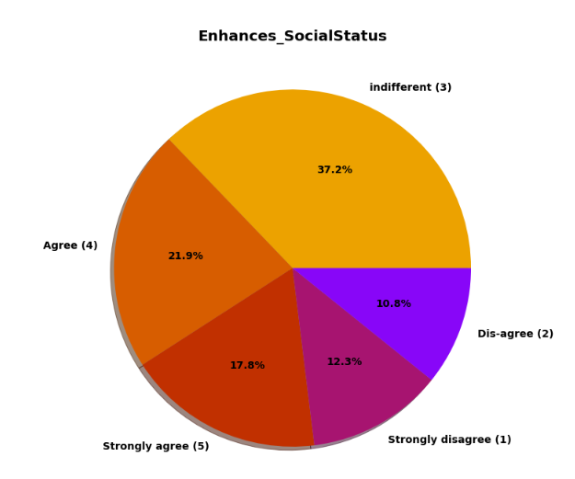
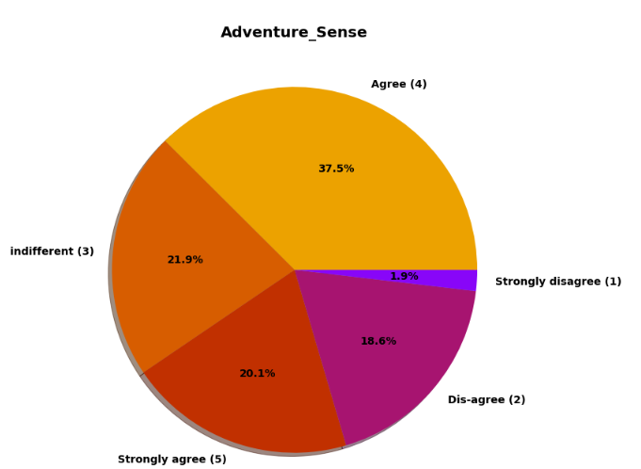
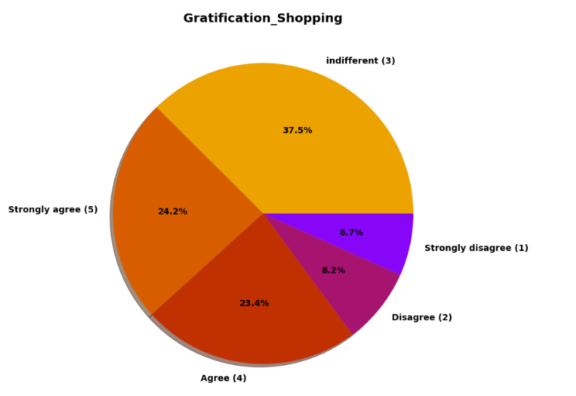
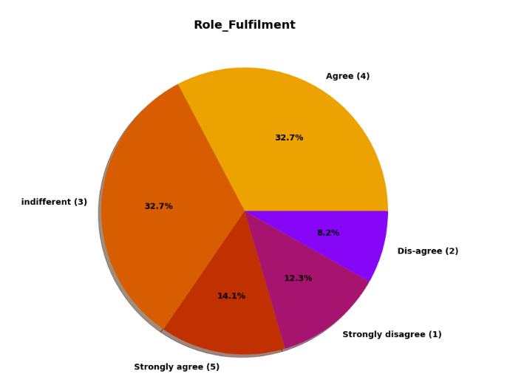
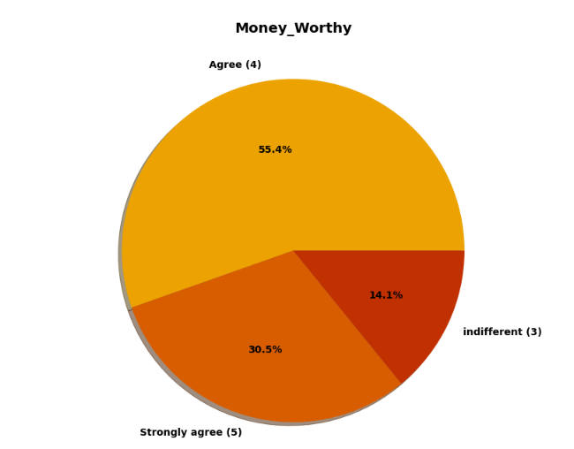

Slide 35
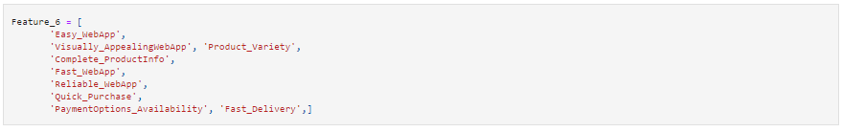
Exploring Opinion on Online Shopping Platform Websites by Customer
In this section we will analyzed features related to website or application like performance, web layout.

Slide 36
Insights:
Majority, 64 customers agree that Amazon.in, Flipkart.com, Paytm.com, Myntra.com, Snapdeal.com are Easy to use website or application.
87 customers agree that Amazon.in, Flipkart.com have Visual appealing web-page layout than most of other market players.
Around according to 125 people Amazon.in, Flipkart.com provides wide variety of offer on product.
We already know 50.2% Strongly agree over providing complete relevant product information, and here we can see that 100 customer think that Amazon.in, Flipkart.com provides complete information compare to others.
Previously we know that 42.8 % customer strongly agree and 41.6 % customer agree over high loading & processing speed of website.
In terms of Reliability of website or application again Amazon top list.
Safe & Speed delivery very much deciding factor in terms of purchase. In terms of speed of delivery Amazon.in is much better than other online shopping platform and Flipkart.com worst among all in terms of speed delivery of product.

Slide 37
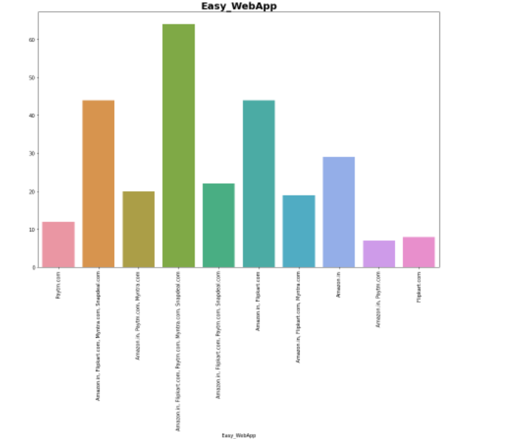


Slide 38






Slide 39
Analysis
Most of Customers are from age range of 20-50 and most of them are female.
Most of the time search engine is used to get into the platform by users.
Many customers uses debit/ credit card for payment.
As we already seen that people mostly like amazon for online purchase for their fast delivery, easy accessibility , trust worthiness products and so on.

Slide 40
CONCLUSION
Frequency of Females shopping is high so making them satisfied will help the sellers to get more business.
Loyal customers prefer buying and tend to spend more money on shopping in your store. Statistics show that engaged consumers purchase more frequently. It is necessary to hear customer feedback because most of them are valuable feedbacks.
Sometimes customer feedback is the best marketing strategy. They are frequent customers so they will know which areas of your business may well be improved. If their feedback is approved, they will extremely excite and support your company with their best ability.
Here as an conclusion part I found that using dead old strategies for retailers will effect customer retention.
Organization will always focus on success for that keeping the old customers will always be a plus point.
Also Paytm and Snapdeal has maximum drawbacks it is because of their dead old strategies

Slide 41


